Slide 1
Fundamental Information of this Course
Electromagnetics (电磁学)
Students: Majoring in EE
Feb. 28, 2017 ~ June 15, 2018 (16 weeks)
Classroom: Teaching Center Rm. 302
Lecture: Wednesday & Friday 10:15 ~ 11:55
Lab session: SIST Bldg. Rm. 1D102 Small Class 1: Tuesday 15:00 ~ 16:40 Small Class 2: Thursday 15:00 ~ 16:40 Small Class 3: Friday 15:00 ~ 16:40 Detailed schedule will be determined later
Discussions and Exercises: TBD Quiz: every week in discussion class
Blackboard system: TBD

Slide 2
Information of Instructor
Xiong Wang (王雄), Assistant Professor
Office: SIST Bldg., Rm. 1D301B
Office hour: Wednesday 13:00~15:00
Telephone: 20685264
Email: wangxiong@shanghaitech.edu.cn
WeChat: wangxiong_shtech

Slide 3
Information TAs and Lab Teacher
TAs (grader) 林湛松 linzhs@shanghaitech.edu.cn 倪硕 nishuo@shanghaitech.edu.cn 鲁珉杉 lumsh@shanghaitech.edu.cn 田付谷 tianfg@shanghaitech.edu.cn
TAs (lab) 张大钧 zhangdj@shanghaitech.edu.cn 孙逸飞 sunyf1@shanghaitech.edu.cn 段汉卿 duanhq@shanghaitech.edu.cn 王昱棋 wangyq1@shanghaitech.edu.cn
Lab teacher 李娟 lijuan@shanghaitech.edu.cn

Slide 4
Policies
Attitude: work hard during the entire semester
Integrity: homework, experiments, class projects, quiz, exams (will be included in the final grade)
Attendance: Lecture: required, about 5 random roll call in about 30 lecture days (may be included in the final grade) Lab: required, 0 point for one lab session if absent. Reschedule is possible, but needs to get my permission in advance Quiz: required. Make-up is possible, but get a 30% deduction in the points and no more than two times during this semester. I MUST be informed by email or WeChat before each quiz starts Exam: required, 0 point for one exam if absent and no make-up exam is allowed
Classroom discipline: DO NOT allow playing games and watching videos on smart phones, tablets or laptops in class

Slide 5
Policies (cont.)
Bonus points: 0.5,1 or 1.5 points per time is awarded to students who can answer some of my questions and ask me in-depth questions (will be directly added to the final grade)
Homework: assigned every week and collected next week in class. If you cannot finish it on time, you can turn in on the next class day but with a 20% deduction of the points. No homework is accepted after that. Everyone should try to work on homework problems independently. Discussion between students and searching online is allowed, but you must finally work on it by yourself even if you get some help elsewhere. Copying from each other, copying solutions, or copying the old-version homework of the junior students will be strictly punished

Slide 6
Policies (cont.)
Quiz: quiz is given every week. The problems are fundamental questions, calculations, or derivations based on the two lectures in the past week. All quizzes are close-book, closed-notes, and no cheat sheet is allowed. Any kind of cheating in a quiz will lose all points for quiz in the final grade, and cheating for two times will fail the class
Exams: one midterm and one final. Closed-book and closed-notes, but can take some pages (two for midterm and 3 for final) of A4 size cheat sheet with equations, notes, figures or whatever you want to write on both sides of the papers. You need to get a calculator able to do calculations of complex numbers, exponential operation, trigonometric function and so on. Any kind of cheating in an exam will fail the class

Slide 7
Policies (cont.)
Lab session: students are grouped into teams of 2 members for each lab session. Both team members work together to finish all the required steps for an experiment and write a lab report together. Some reading is needed for some lab sessions before doing the experiments. The equipment and accessories will be used in labs are very expensive, so very careful operation is required and you must follow the guidance of the teach or TAs
The students who rank in the top six based on their overall performance during the whole semester just before the final exam will be exempt from the final exam and get A+ directly. This bonus aims to offer you more time in preparing exams of other courses

Slide 8
Project for EE Major (2 Extra Credits)
Hopefully will start around the 14th week and is extended to the Summer Semester
Different topics to choose. Students are encouraged and welcome to discuss possible topics designed by themselves
Students are grouped into teams of 2 or 3 and each team work on the selected topic together
Each project topic involves literature study, theoretical design, simulation using software, coding, fabrication, measurement, and report writing
Some topics can be further explored to gain you more experience in research and publishing a paper is also possible

Slide 9
Major Purposes of This Course
Expose you with fundamental knowledge, phenomenon, and applications of electromagnetics

Slide 10
Teaching Style
Not only knowing the hows but also the whys
Intuitive interpretation and practical examples of some elusive concepts, theorems, formulas, and phenomena. In another word, using physics to explain mathematics and taking advantage of some intuitive examples to unravel physics
Try to make you understand the most basic and important concepts in class

Slide 11
Syllabus
See your handouts

Slide 12
Chapter 1 Overview
Electrostatics (does not change with time)
Magnetostatics (does not change with time)
Electromagnetics (vary with time, i.e. time-varying)
Electrostatics
DC
Decoupled
Fields
Force
Magnetostatics
Electromagnetics
AC
Coupled
Waves
Energy

Slide 13
Fields of Moving Charges
A good resource
http://phet.colorado.edu/sims/radiating-charge/radiating-charge_en.html
A static charge produces static electric field at the speed of light
When a charge is moving, the generated electric fields change accordingly
When the charge moves with acceleration, the generated electric fields exhibit oscillating natures, which will in turn generate magnetic fields and form electromagnetic fields

Slide 14
Examples of EM Applications

Slide 15
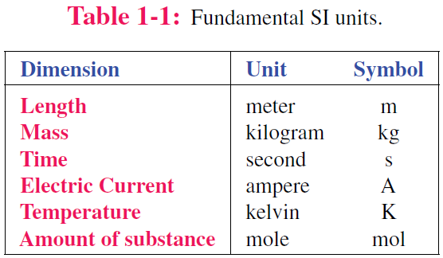
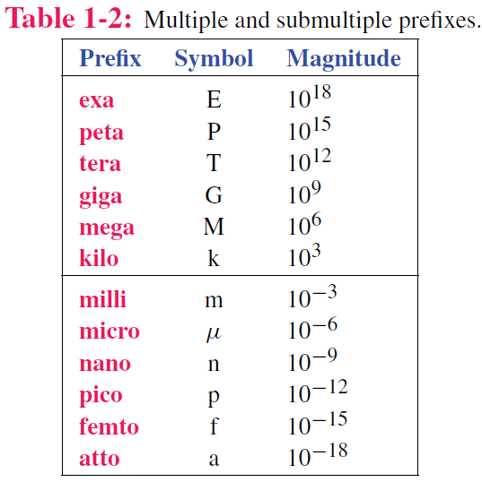
Dimensions and Units
Luminous intensity candela cd

Slide 16
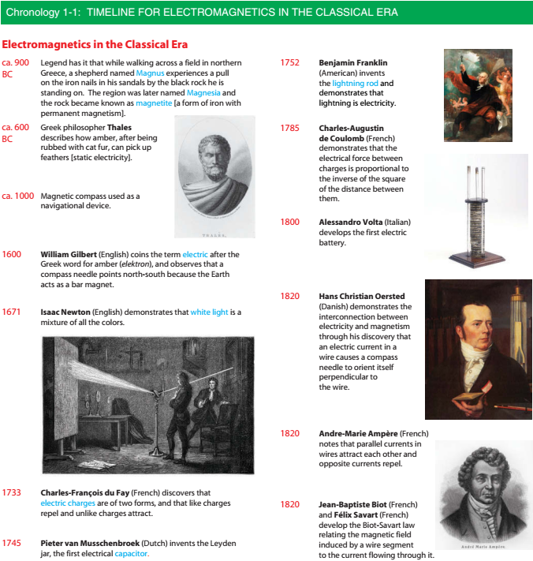

Slide 18
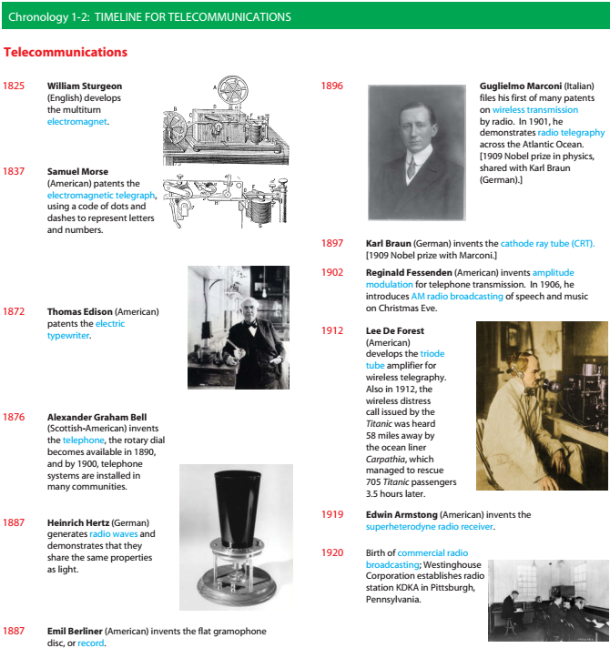

Slide 20
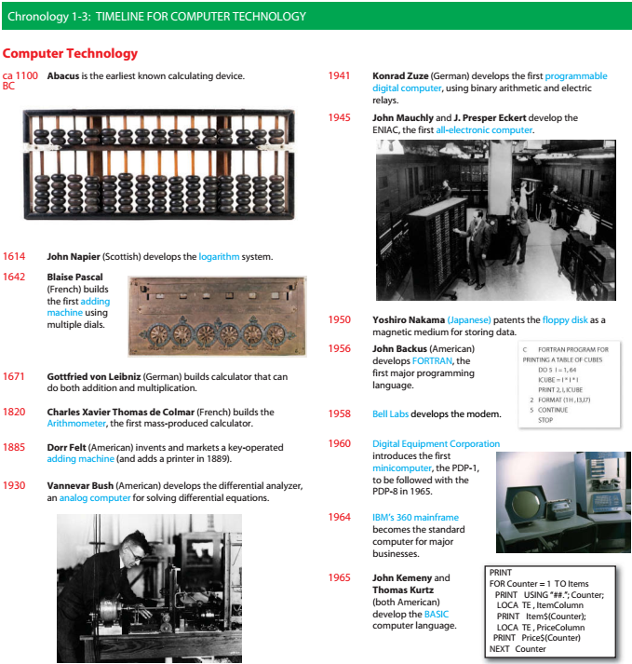

Slide 22

Our WeChat Group

Slide 23
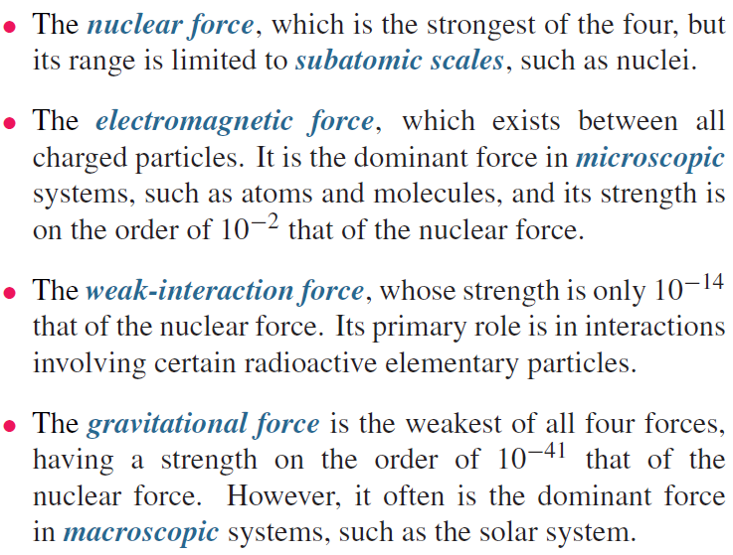
Fundamental Forces of Nature

Slide 24
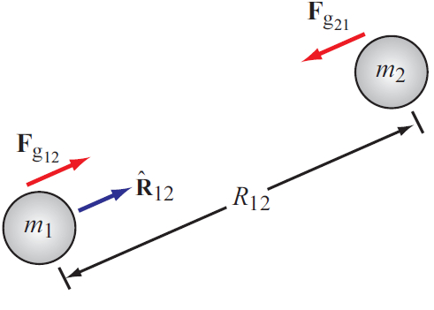
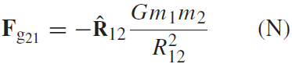
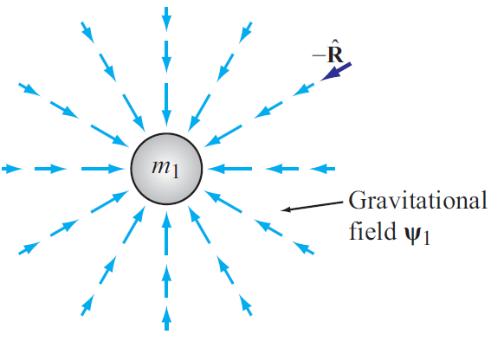
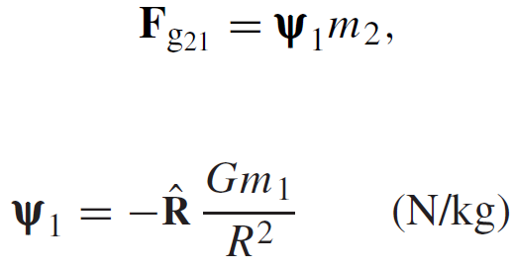
Gravitational Force
Force exerted on mass 2 by mass 1
Action at a distance
Gravitational FIELD induced by mass 1

Slide 25
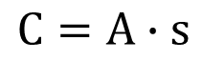
Charge: Electrical property of particles
Units: coulomb
$$C=A∙s$$
One coulomb: amount of charge accumulated in one second by a current of one ampere.
1 coulomb represents the charge on ~ 6.241 x 10¹⁸ electrons
The coulomb is named for a French physicist, Charles-Augustin de Coulomb (1736-1806), who was the first to measure accurately the forces exerted between electric charges.
Charge of an electron
e = 1.602 x 10⁻¹⁹ C
Charge conservation
Cannot create or destroy charge, only transfer

Slide 26
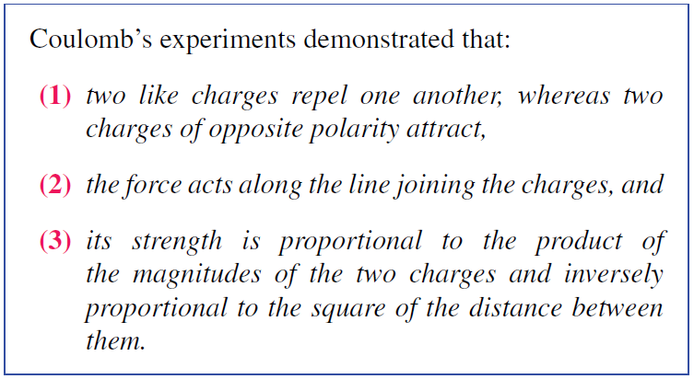
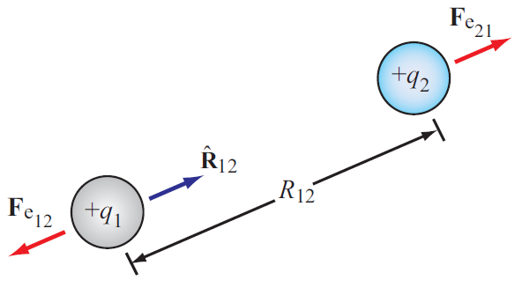
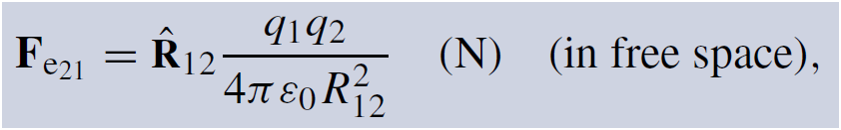
Electrical Force
Two differences between F_{g} and F_{e}
Force exerted on charge 2 by charge 1
ε₀ = 8.854 × 10⁻¹² farad per meter (F/m)
Permittivity of free space

Slide 27
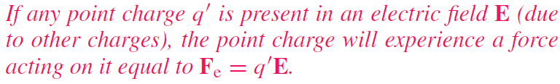
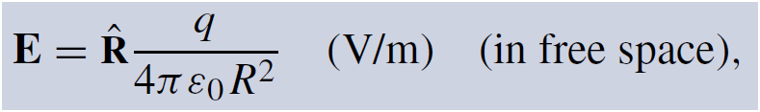
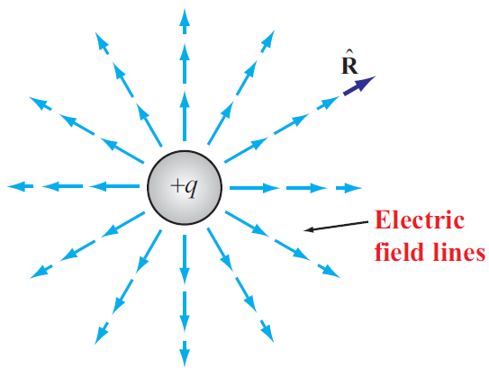
Electric Field In Free Space
Permittivity of free space

Slide 28
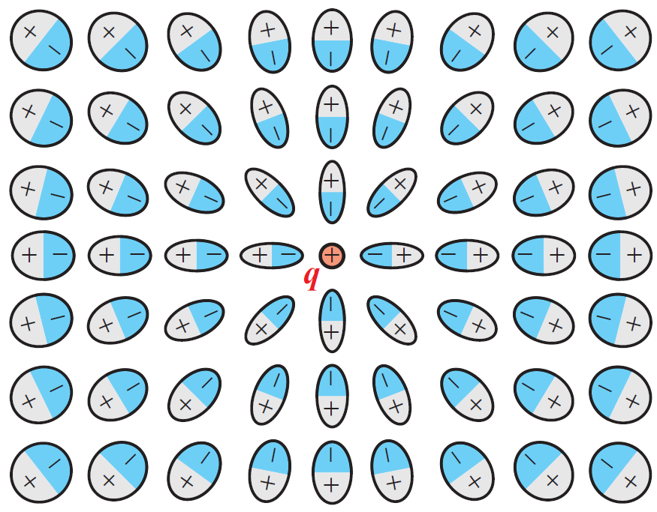
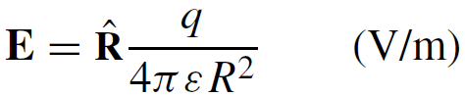
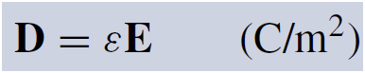
Electric Field Inside Dielectric Medium
Polarization of atoms changes electric field
New field can be accounted for by changing the permittivity
Permittivity of the material
Another quantity used in EM is the electric flux density D:
Electric dipole
The fields of dipoles tend to counteract the field due to the positive charge

Slide 29
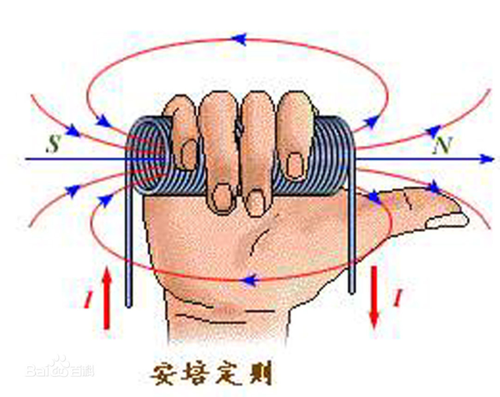
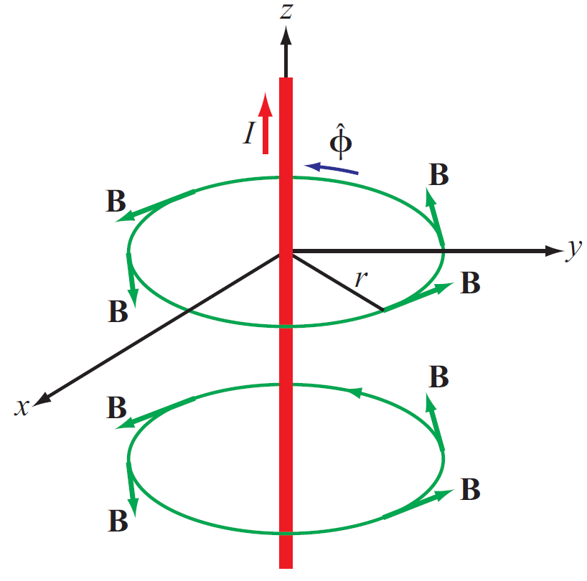
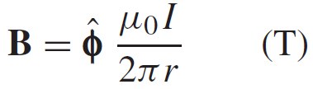
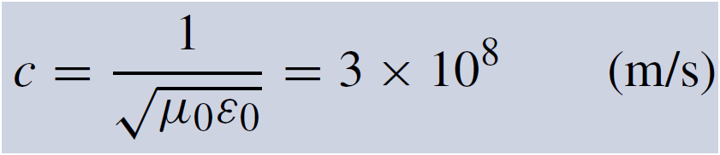
Magnetic Field
Electric charges can be isolated, but magnetic poles always exist in pairs.
Magnetic field induced by a current in a long wire
Magnetic permeability of free space
Electric and magnetic fields are connected through the speed of light:

Slide 30
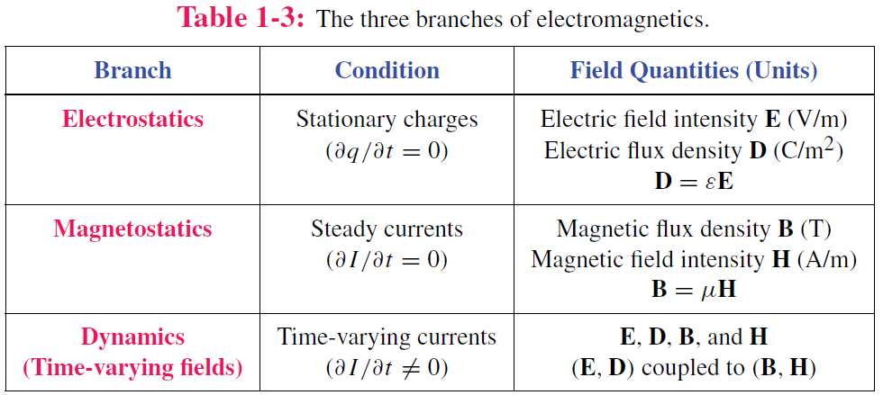
Static vs. Dynamic
Static conditions: charges are stationary or moving, but if moving, they do so at a constant velocity.
Under static conditions, electric and magnetic fields are independent, but under dynamic conditions, they become coupled.

Slide 31
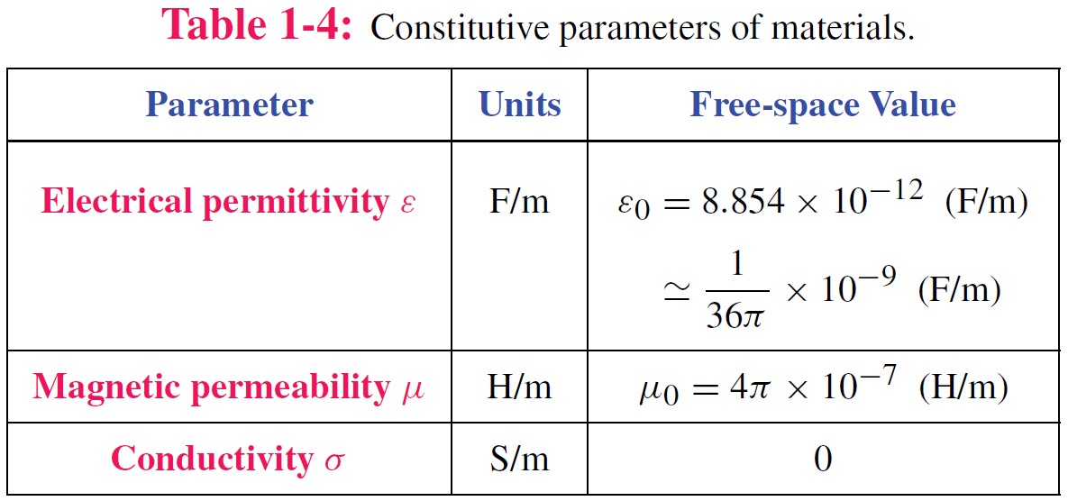
Material Properties

Slide 32
Traveling Waves
Waves carry energy
Waves have velocity
Many waves are linear: they do not affect the passage of other waves; they can pass right through them
Transient waves: caused by sudden disturbance
Continuous periodic waves: repetitive source

Slide 33
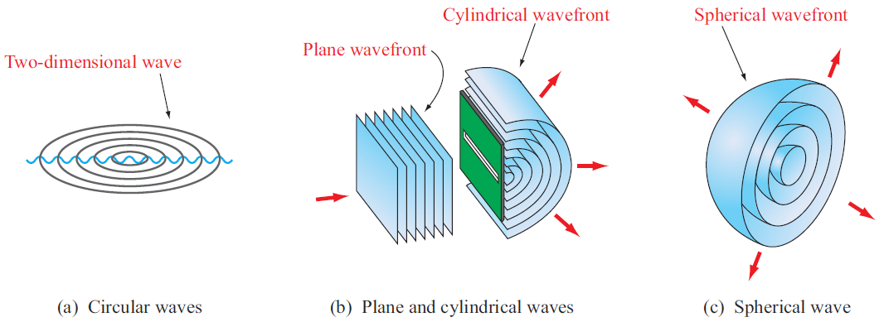
Types of Waves
Surface with equal phase

Slide 34
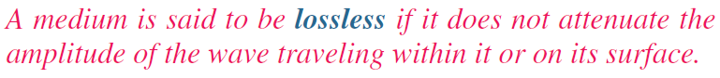
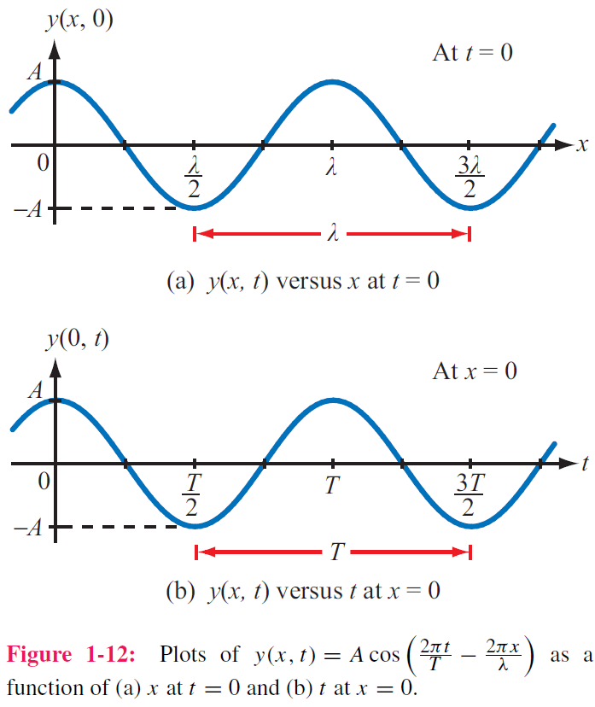
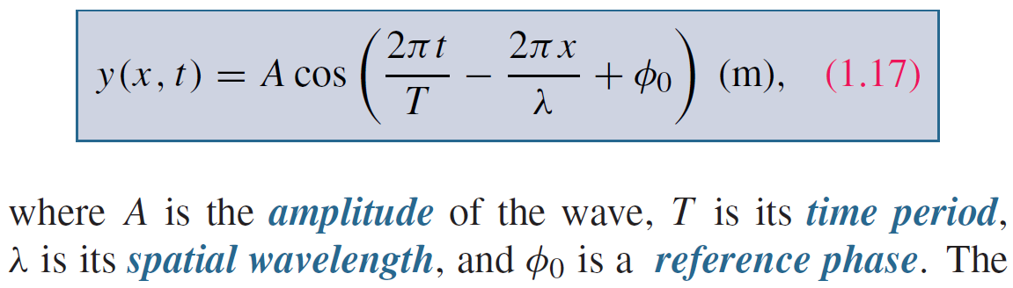
Sinusoidal Waves in Lossless Media
Take wave on water as an example
y = height of water surface
x = distance
Function of both time and space

Slide 35
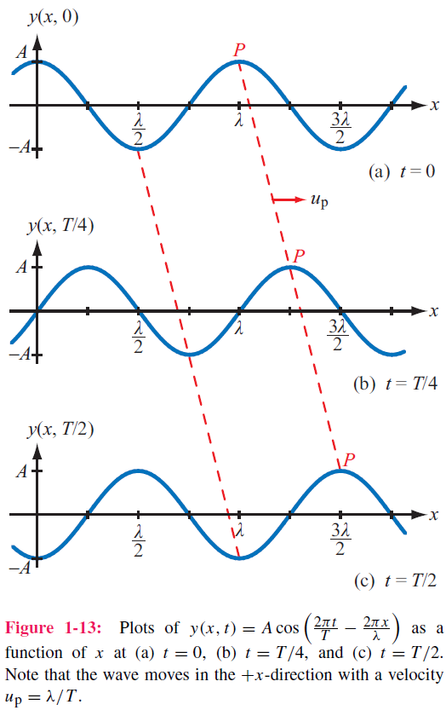
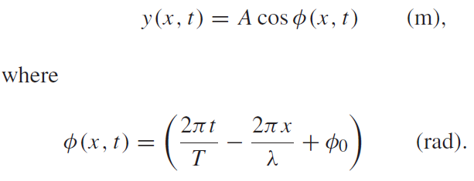
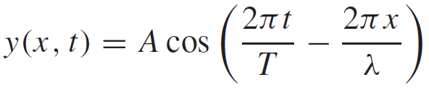
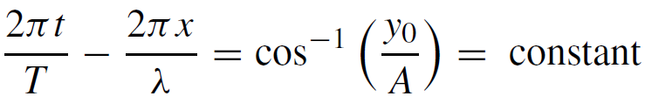
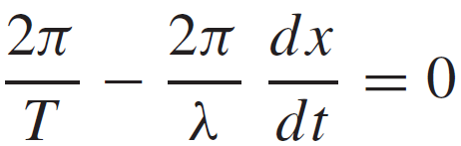
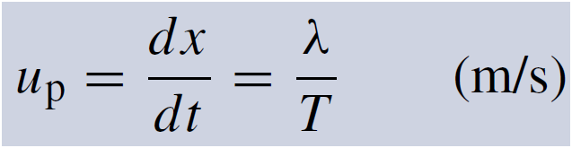
Phase velocity
If we select a fixed height y₀ and follow its progress, then
=

Slide 36
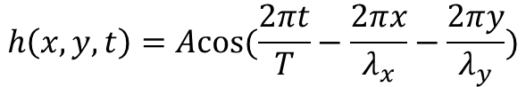
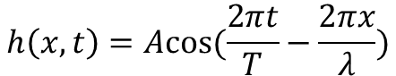
More Interpretation of Spatial Variables
The spatial variables in the cos function represent the directions in which the wave has propagation
$$h\left(x,t\right)=Acos(\frac{2πt}{T}−\frac{2πx}{λ})$$
$$h\left(x,y,t\right)=Acos(\frac{2πt}{T}−\frac{2πx}{λ_{x}}−\frac{2πy}{λ_{y}})$$

Slide 37
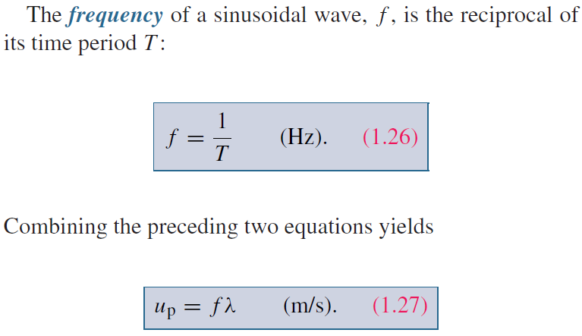
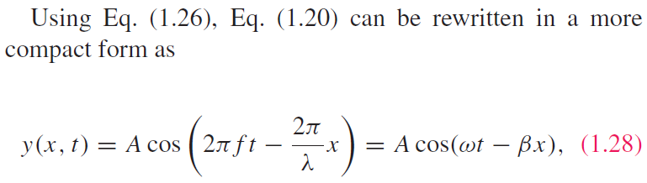
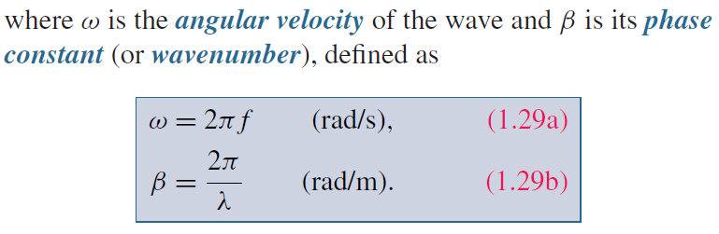
Wave Frequency and Period

Slide 38
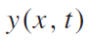
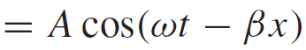
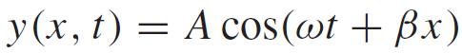
Direction of Wave Travel
Wave travelling in +x direction
As t increases, x has to increase to make (ωt − βx) constant
Wave travelling in ‒x direction
As t increases, x has to decrease to make (ωt + βx) constant
+x direction: if coefficients of t and x have opposite signs
‒x direction: if coefficients of t and x have same sign (both positive or both negative)

Slide 39
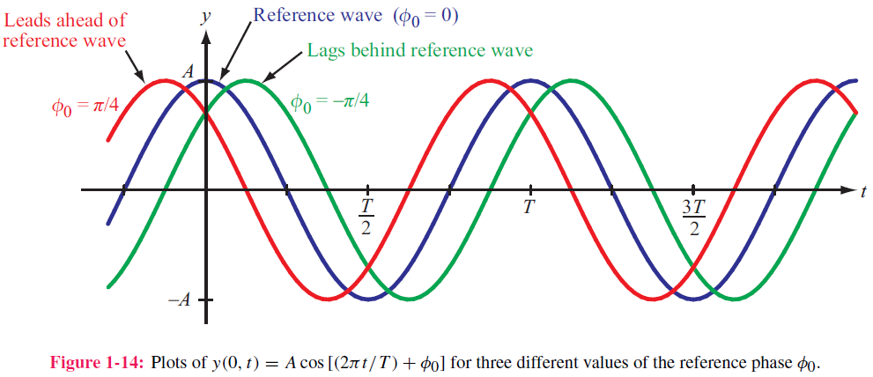
Phase Lead & Lag
t₀
t₀−T/4
T₀+T/4

Slide 40
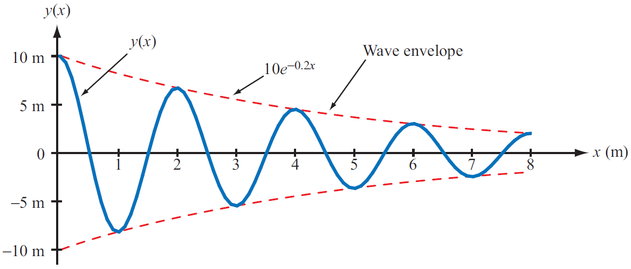
Wave Travel in Lossy Media
Frequency does not change
Attenuation factor

Slide 41
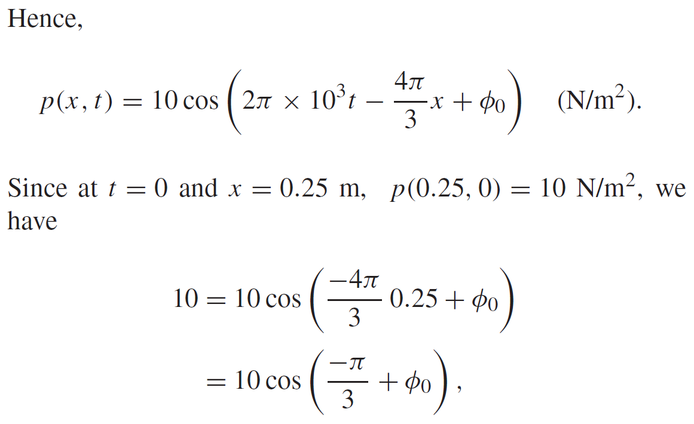
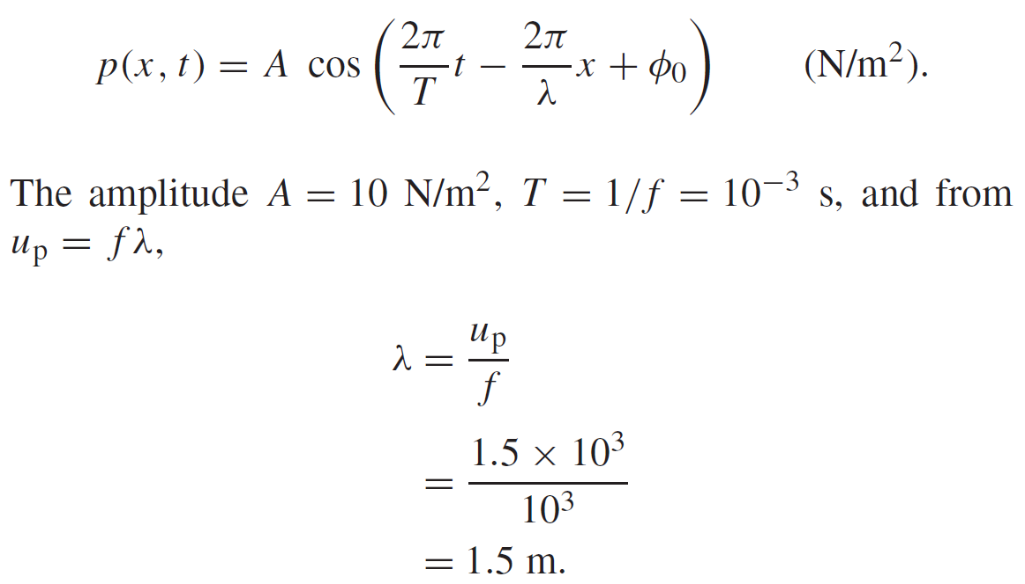
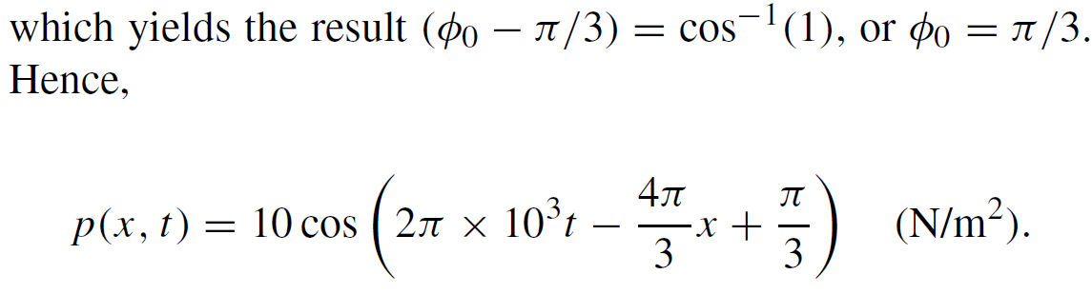
Example 1-1: Sound Wave in Water
Given: sinusoidal sound wave traveling in
the positive x-direction in water
Wave amplitude is 10 N/m2, and p(x, t) was observed to be at its maximum value at t = 0 and x = 0.25 m. Also f=1 kHz, up=1.5 km/s.
Determine: p(x,t)
Solution:

Slide 42
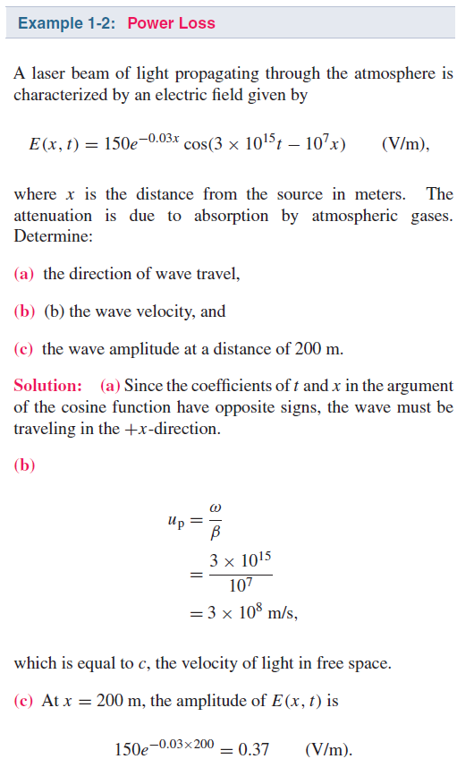

Slide 43


The EM Spectrum

Slide 44


Slide 45

Complex Numbers
We will find it is useful to represent sinusoids as complex numbers
Rectangular coordinates
Polar coordinates
Relations based on Euler’s Identity

Slide 46

Relations for Complex Numbers
Learn how to perform these with your calculator/computer

Slide 47

Phasor Domain
1. The phasor-analysis technique transforms equations
from the time domain to the phasor domain.
2. Integro-differential equations get converted into
linear equations with no sinusoidal functions.
3. After solving for the desired variable--such as a particular voltage or current-- in the phasor domain, conversion back to the time domain
provides the same solution that would have been obtained had the original integro-differential equations been solved entirely in the time domain.

Slide 48





Phasor Domain
Phasor counterpart of
Phase is needed

Slide 49

Time and Phasor Domain
It is much easier to deal with exponentials in the phasor domain than sinusoidal relations in the time domain
Just need to track magnitude/phase, knowing that everything is at frequency ω

Slide 50

Phasor Relation for Resistors
Current through resistor
Time domain
Time Domain
Frequency Domain
Phasor Domain

Slide 51


Phasor Relation for Inductors
Time domain
Phasor Domain
Time Domain

Slide 52


Phasor Relation for Capacitors
Time domain
Time Domain
Phasor Domain

Slide 53
Example
Integral property

Slide 54







ac Phasor Analysis: General Procedure

Slide 55
Example 1-4: RL Circuit
Cont.

Slide 56
Example 1-4: RL Circuit cont.

Slide 57

Travelling Waves in Phasor Domain

Slide 58

Summary

